Slide 1
IE251 Spring 2024 Tecnomatix Plant Simulation Session No. 1
Lennard Heuer, Ph.D. Candidate
KAIST Department of Data Science
lennard.heuer@kaist.ac.kr

Slide 2
Contents
1. Overview of Functionalities
In-Class Exercises
Homework

Slide 3
1. Overview of Functionalities

Slide 4
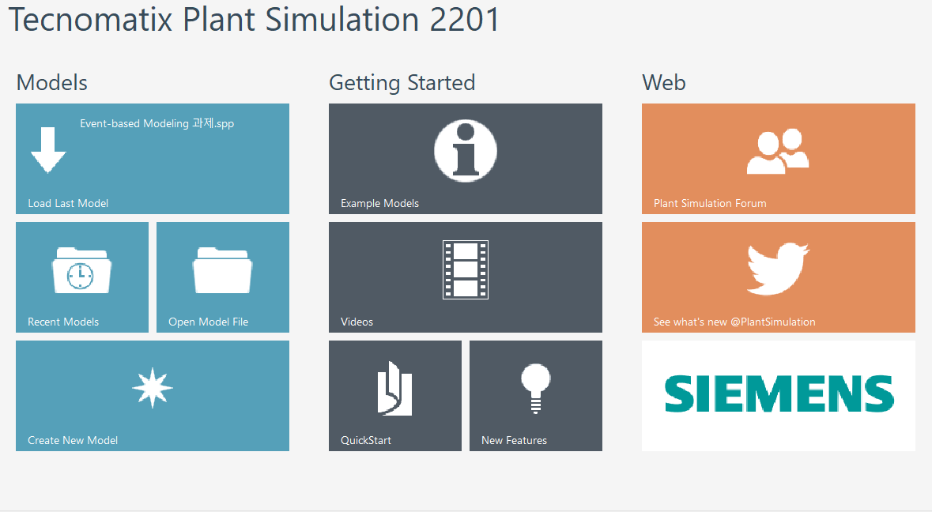
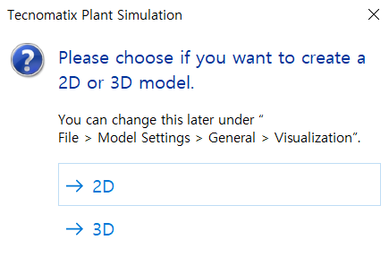
Overview Functionalities - Model Creation
Click [Creation New Model] - [2D]
②
①
Notes:
The first page is for model creation. Just follow the sequnces.

Slide 5
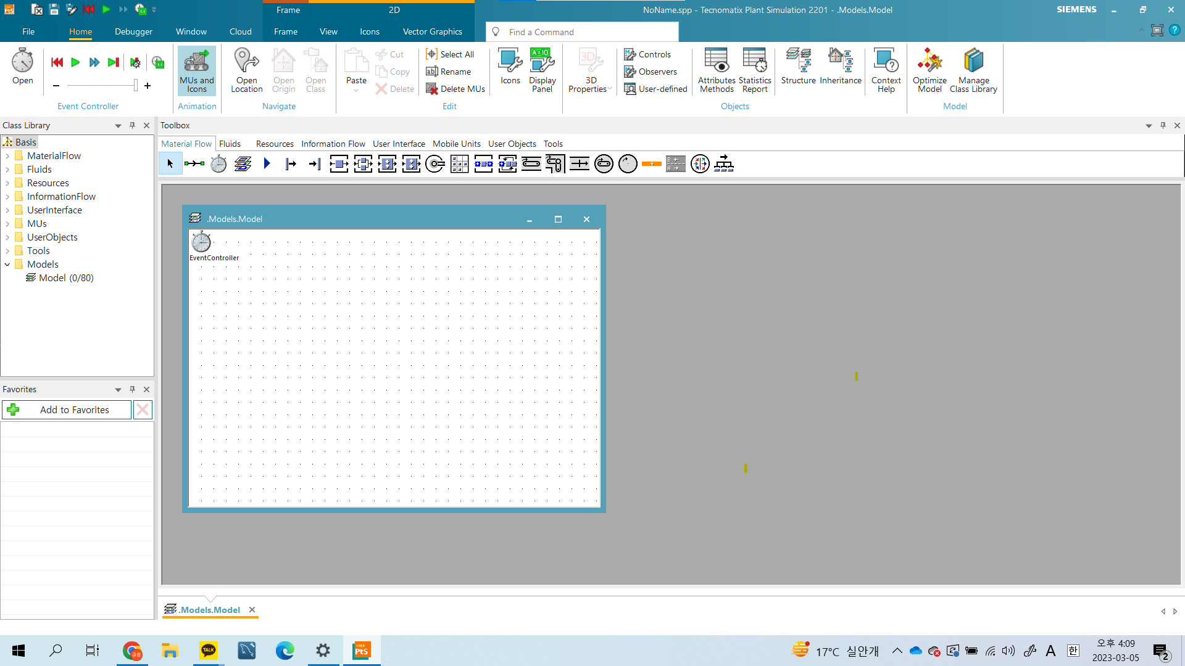
Overview Functionalities - Toolbox
Using a toolbox can make it easier for users to utilize objects effectively.
Toolbox
Notes:
When you finished model creation, you can see this window. In the middle of window, there is highlighted box. We call it toolbox. It is made for creating object. When you want to make any object, use the toolbox.

Slide 6
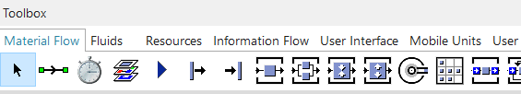




Overview Functionalities - Basic object[1/2]
Connector: establishes connections between two objects
Source: produces parts(job)
Drain: removes the parts from the plant
Station: processes parts
Buffer: temporarily holds parts
Notes:
These icons represent objects. The highlighted objects are what we are going to use mainly.

Slide 7





Overview Functionalities - Basic object[2/2]
Method: is used to control other objects in programming.
Variable: is global variable that other objects can access
DataTable: is a list with two or more columns
Dataqueue: a list with one column
In the toolbox, you can create any object on the map by dragging and dropping it onto the map.
Notes:
In the toolbox, you can create any object on the map by dragging and dropping it onto the map.

Slide 8
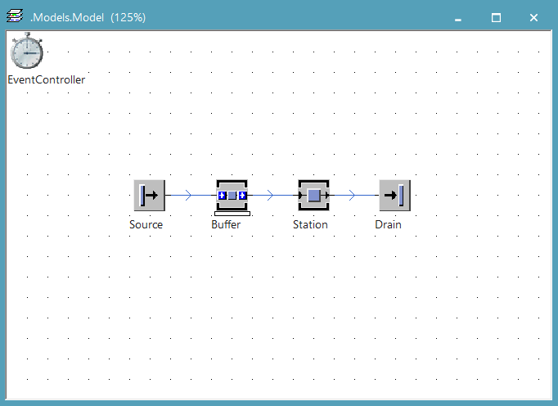
Overview Functionalities - Sandbox Model
Notes:
This is a simplest model. One thing I want to say is that Source and Drain is mandatory in plant simulation. Please remember that

Slide 9
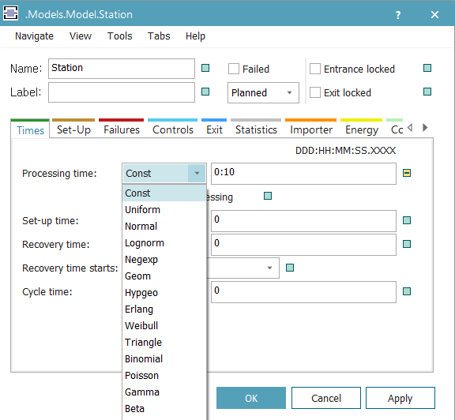

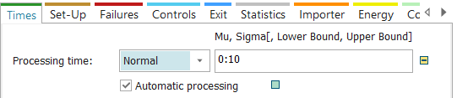
Overview Functionalities - Processing time setting
Double click the Station icon on the map
EX1. Exponential distribution
EX2. Normal distribution
Mean: 10 min
Standard deviation: 5 min
Lower bound: 2 min
Upper bound: 15 min
10:00,5:00,2:00,15:00
Notes:
This page is for processing time setting. You can set processing time by some clicking. Right side is good example for setting.

Slide 10
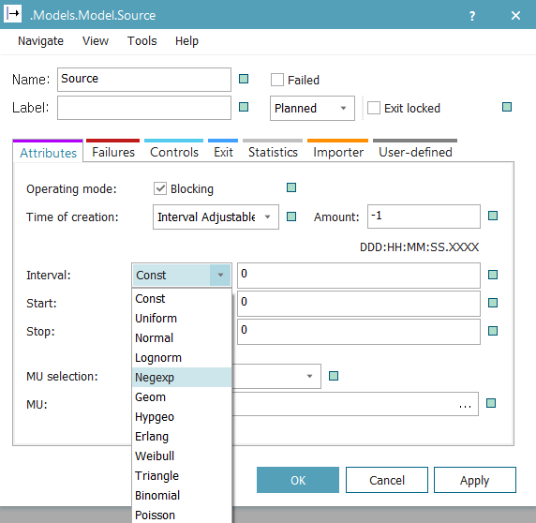
Overview Functionalities - Arrival time setting
Double click the Source icon on the map
It is same as processing time setting
You can also set the number of parts that Source generates.
‘-1’ means infinite.
Notes:
You can also set arrival time. It is same as before

Slide 11
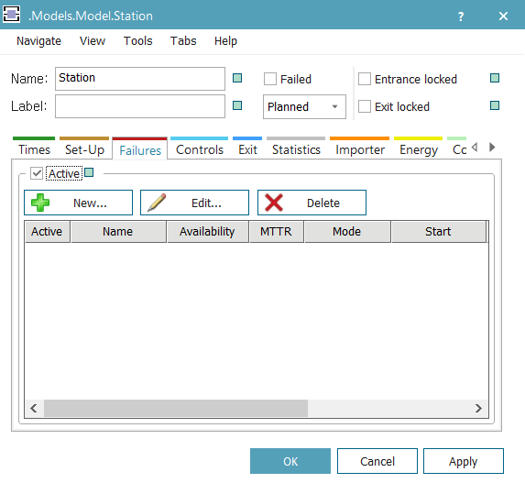
Overview Functionalities - Failure setting[1/2]
Double click the station icon on the map
Notes:
This page is for failure setting. Just follow the sequence.

Slide 12
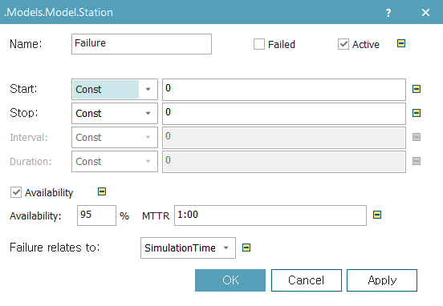
Overview Functionalities - Failure setting[2/2]
You can set MTTR and Availability, then automatically MTTF is determined.
Notes:
One thing I want to say is when you set mttr, availability, then automatically MTTF is determined.

Slide 13
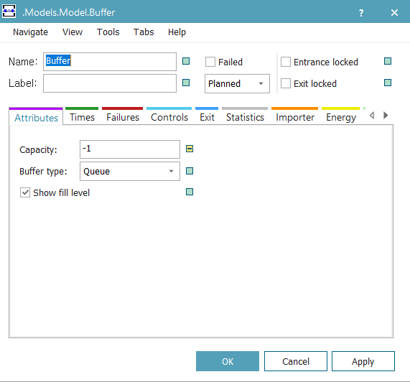
Overview Functionalities - Buffer Setting
Double click the Buffer icon on the map
You can specify the capacity of the buffer. To allow for unlimited capacity, enter a value of -1.
Notes:
When you set buffer, one thing I want to say is the -1 capacity means infinite buffer. Please remember that.

Slide 14
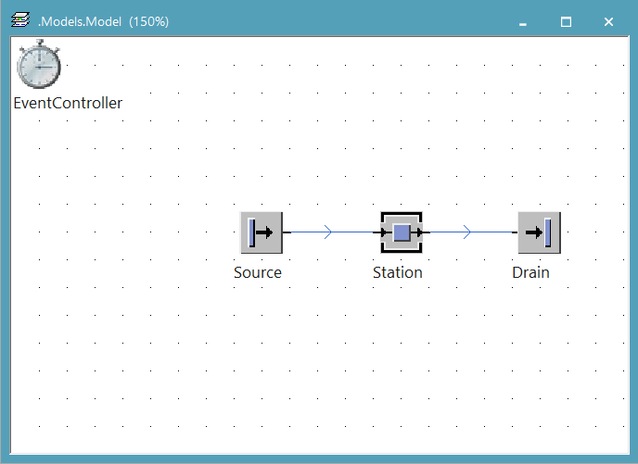
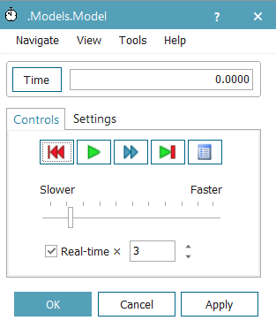
Overview Functionalities - Simulation Execution
reset
Execution
Notes:
When you finished simulation modeling, then you can execture simulation like that. Click execution button then click reset button.

Slide 15
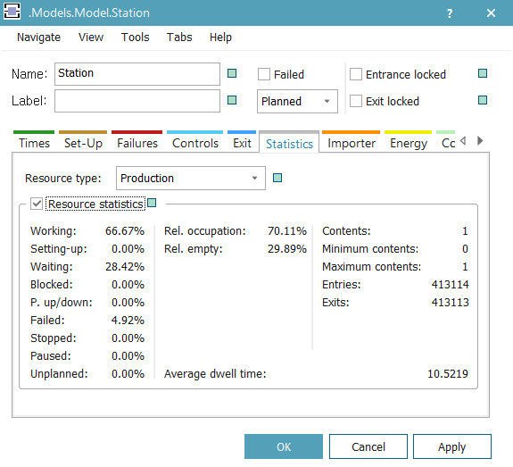

Overview Functionalities - Statistics
You can view the statistics for each object in the [statistics] tab.
①
②
To view the exact definition of each item, click the [?] button located in the upper-right corner of the window, and then click data of item you're interested in.
Notes:
You can also analyze the statics of each object. There is statics tab in each object. Just read the value.

Slide 16
2. In-Class Exercises
Notes:
This is end of the overview. For now, we are going to do group activity. Let’s get start it. If you have any question, raise your hand!

Slide 17
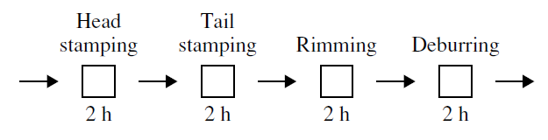
Task 1 - Penny Fab – Exponential Distribution
Penny Fab is as illustrated below, and processing times follow exponential distribution. Each machine takes two hours on average to process.

Slide 18

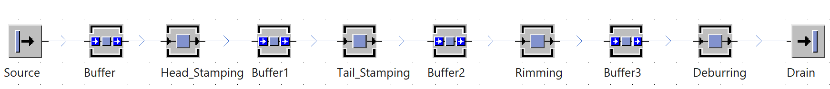
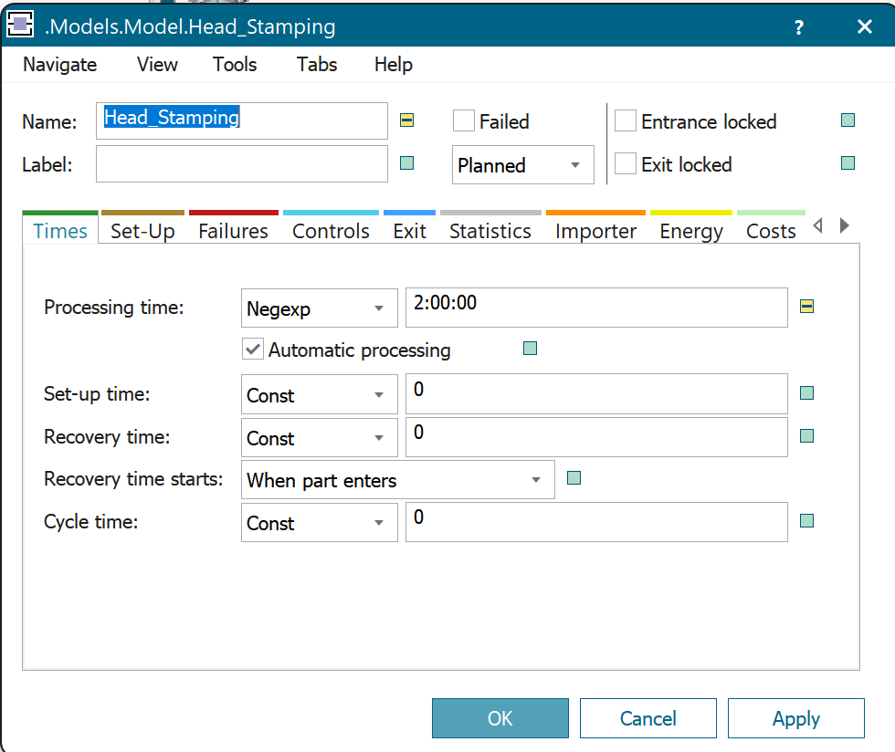
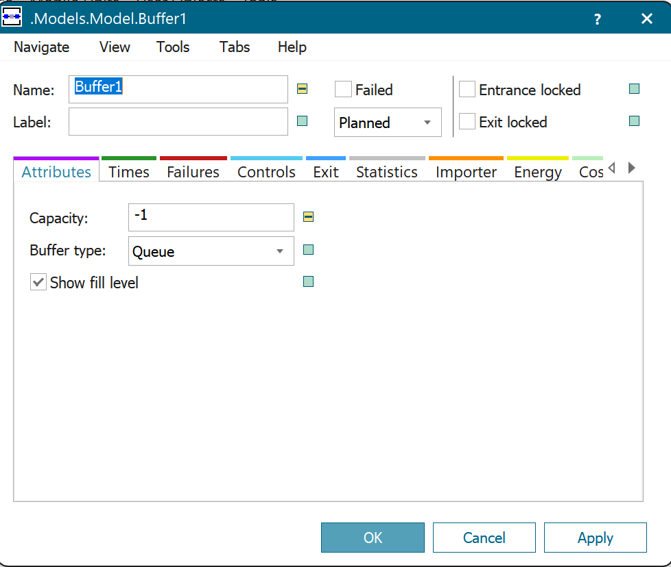
Task 1 - Penny Fab One
Use F2 to rename the workstations
For all workstations, select ‘Negexp’ and 2:00:00 (exponential, 2h average)
Buffers don’t need to be changed
Connect Sources, Buffers, Workstations, and Drain using Connectors

Slide 19
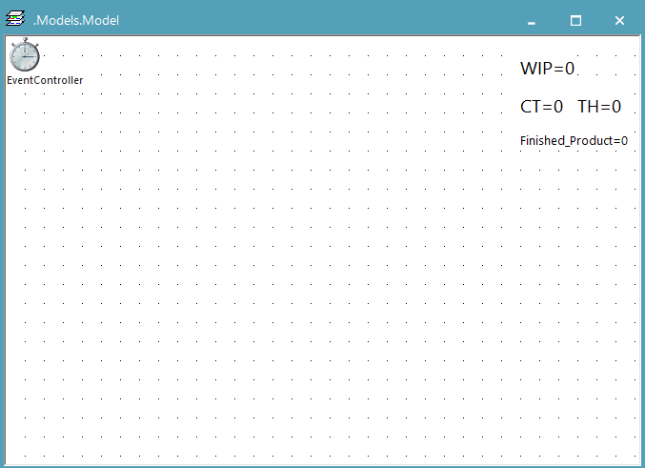
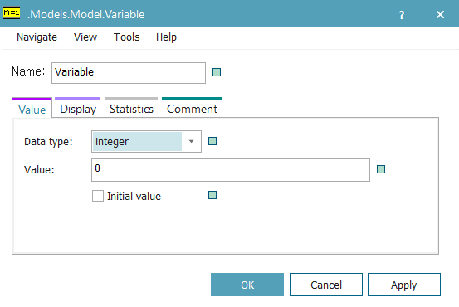
Task 1 - Object setting – Variable
Create a Variable object on the map and double-click it. Follow the table to change the name and data type of the Variable. These Variables show cycle time, WIP, TH and the number of processed products.
(If you want to view them in a larger size, click on ‘display’ tab and then select ‘Font size’.)
Name | Data type
CT | real
WIP | integer
TH | real
Finished_Product | integer

Slide 20
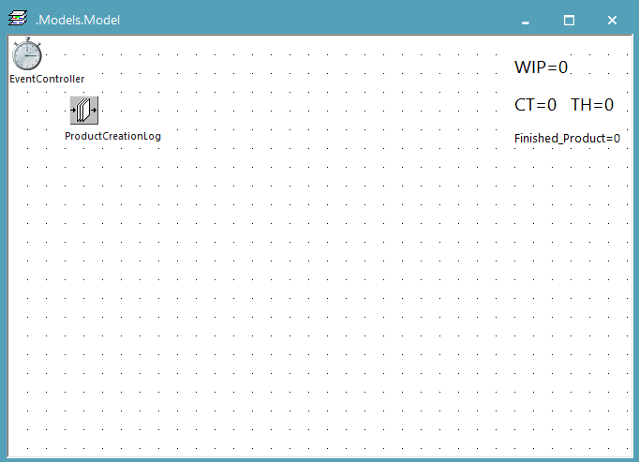
Task 1 - Object setting – Product creation log[1/2]
Create a DataQueue object on the map, right-click it and select 'Rename'. Change the name to 'ProductCreationLog'.

Slide 21
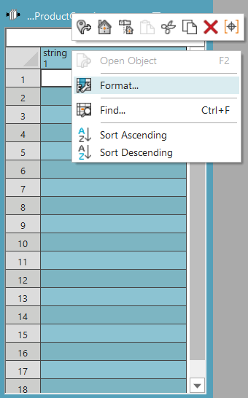
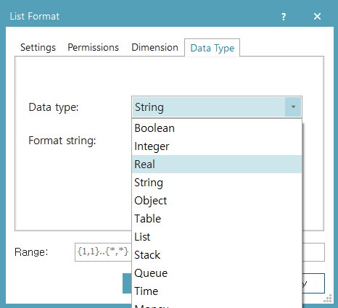
Task 1 - Object setting – Product creation log[2/2]
Double-click on the object, then right-click on the header of the first column and select 'Format' to change the data type to 'real'.

Slide 22
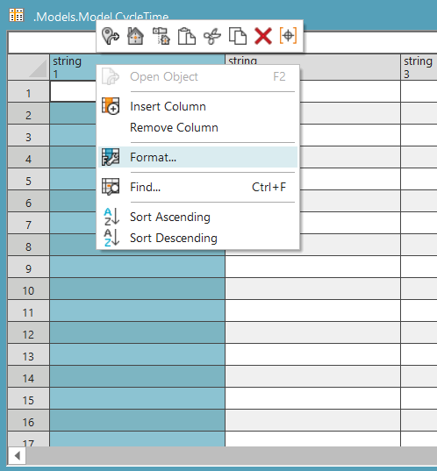
Task 1 - Object setting – Cycle time
Create a DataTable object on the map in the same way as before, and rename it to 'CycleTime'. Then, change the data type of the first column to 'real'. This DataTable is used to store the cycle time of all parts.

Slide 23
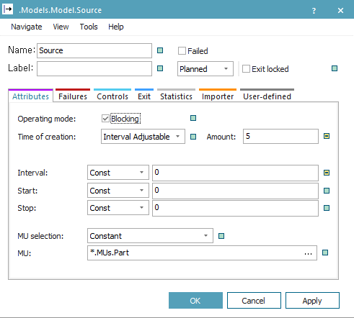
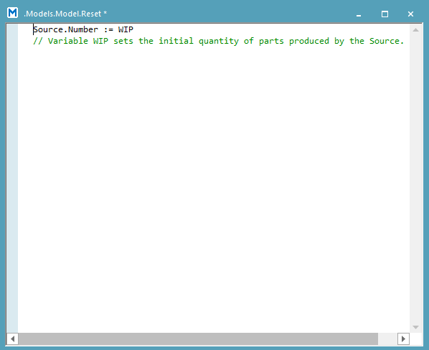
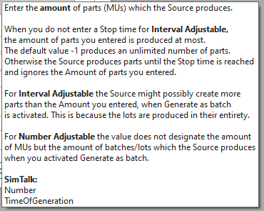
Task 1 - Object Setting – SimTalk
SimTalk is a programming language utilized in Plant Simulation that allows for a more precise configuration of the simulation environment. Every object has its own unique properties and functions, and you can access the syntax for these by clicking on the [?] button. Here is a simple example of using SimTalk
①
path
②

Slide 24
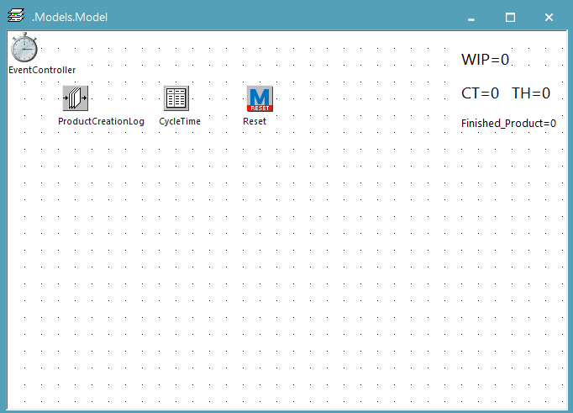
Task 1 - Object Setting – Reset method[1/2]
Create a Method object on the map in the same way as before and rename it to 'Reset'. This will change the icon of the object.

Slide 25
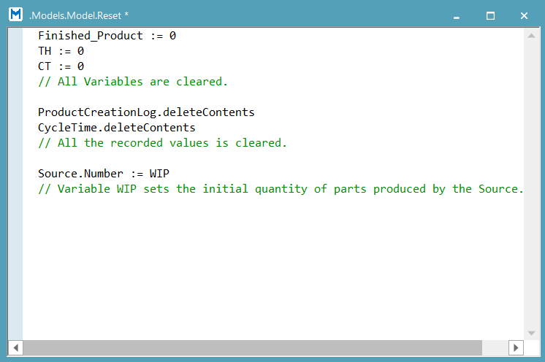
Task 1 - Object Setting – Reset method[2/2]
Double-click on the object and write the following code in the Reset method, which is explained in more detail in the comments below. This code will be executed when you click the 'reset' button of the 'EventController' object. You can think this as initialization
reset
Notes:
Finished_Product := 0 TH := 0 CT := 0 Source.Number := WIP ProductCreationLog.deleteContents CycleTime.deleteContents

Slide 26
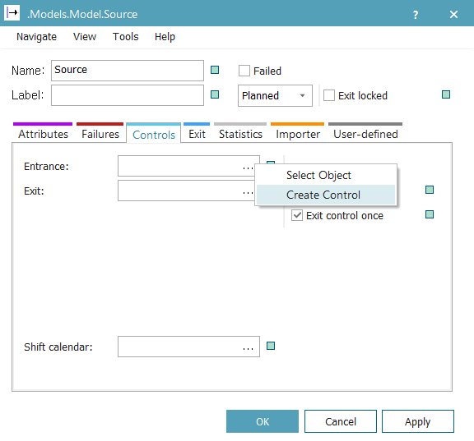
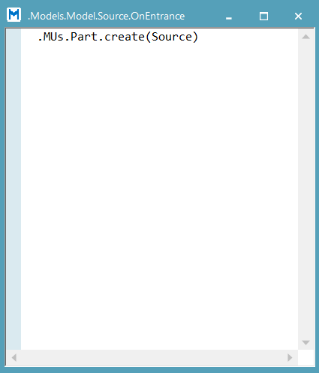
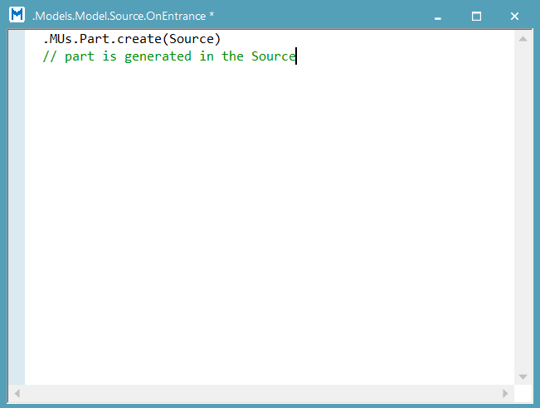
Task 1 - Method setting – Source[1/2]
Double-click the 'Source' icon on the map, go to the 'Controls' tab, and click the '...' button in the ‘Entrance’ section to create a method. Then, write the following code in the method. The ‘Entrance' method is executed when a job arrives at this object.
Notes:
.MUs.Part.create(Source)

Slide 27
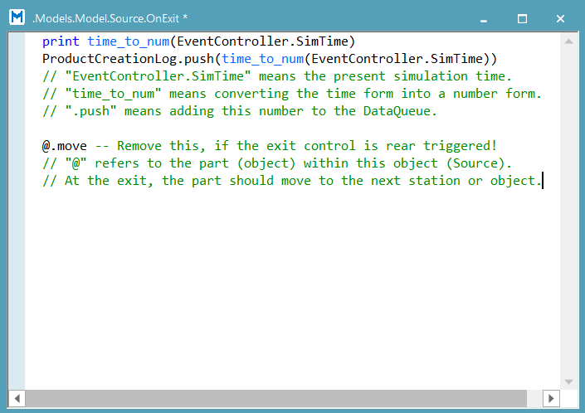
Task 1 - Method setting – Source[2/2]
Create a method in the ‘Exit’ section following the same steps as before. Write the following code in the method. The 'Exit' method is executed when a job leaves this object.
Notes:
print time_to_num(EventController.SimTime) ProductCreationLog.push(time_to_num(EventController.SimTime)) @.move -- Remove this, if the exit control is rear triggered!

Slide 28
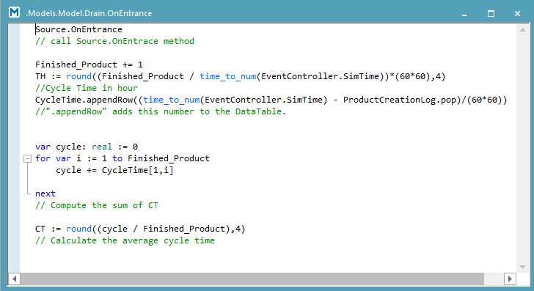
Task 1 - Method setting – Drain
Double-click the ‘Drain' icon on the map. Create a method in the ‘Entrance’ section following the same steps as before. Write the following code in the method.
Notes:
Source.OnEntrance Finished_Product += 1 //Finished Product per hour TH := round((Finished_Product / time_to_num(EventController.SimTime))*(60*60),4) //Cycle Time in hour CycleTime.appendRow((time_to_num(EventController.SimTime) - ProductCreationLog.pop)/(60*60)) var cycle: real := 0 for var i := 1 to Finished_Product cycle += CycleTime[1,i] next CT := round((cycle / Finished_Product),4)

Slide 29
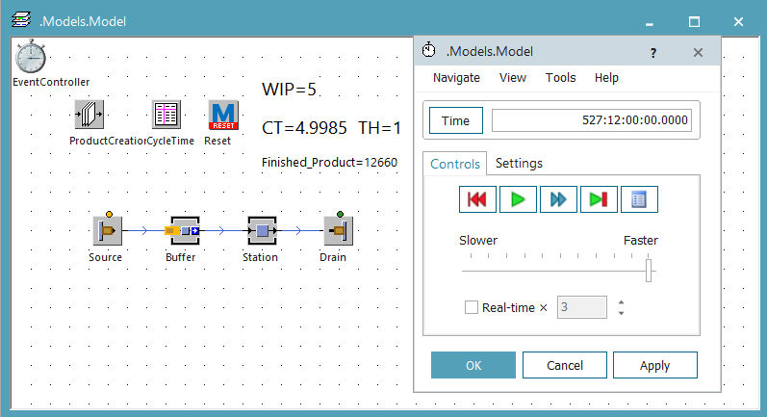
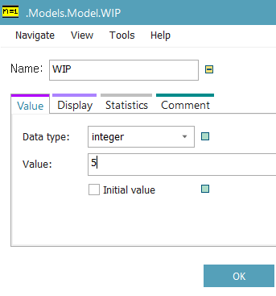
Task 1 - Setting Completion
Now we have created a model with a constant WIP. If you want to change the WIP, simply update the value of the 'WIP’ Variable and run the simulation again! You can think of the 'WIP’ Variable as the input, and the 'CT', 'TH', and 'Finished_product’ Variable as the output.
For our simulation sessions: If not explained otherwise, create at least 10.000 finished products

Slide 30
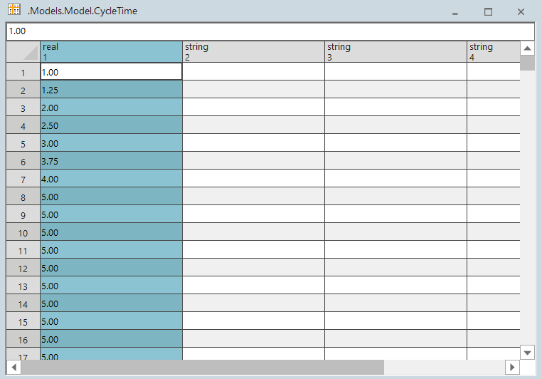
Task 1 - Data Access
If you want to view the cycle time values, you can check them in the 'CycleTime' object. Additionally, if you wish to analyze the data further, Excel can be a useful tool.

Slide 31
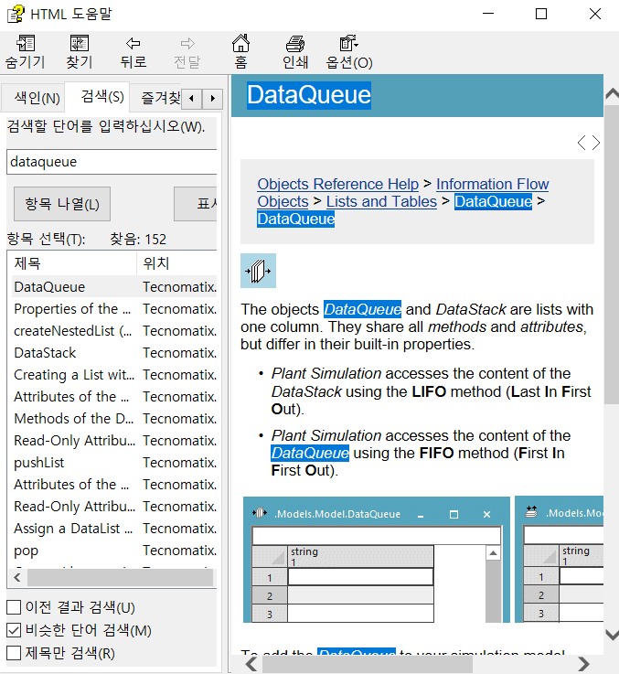
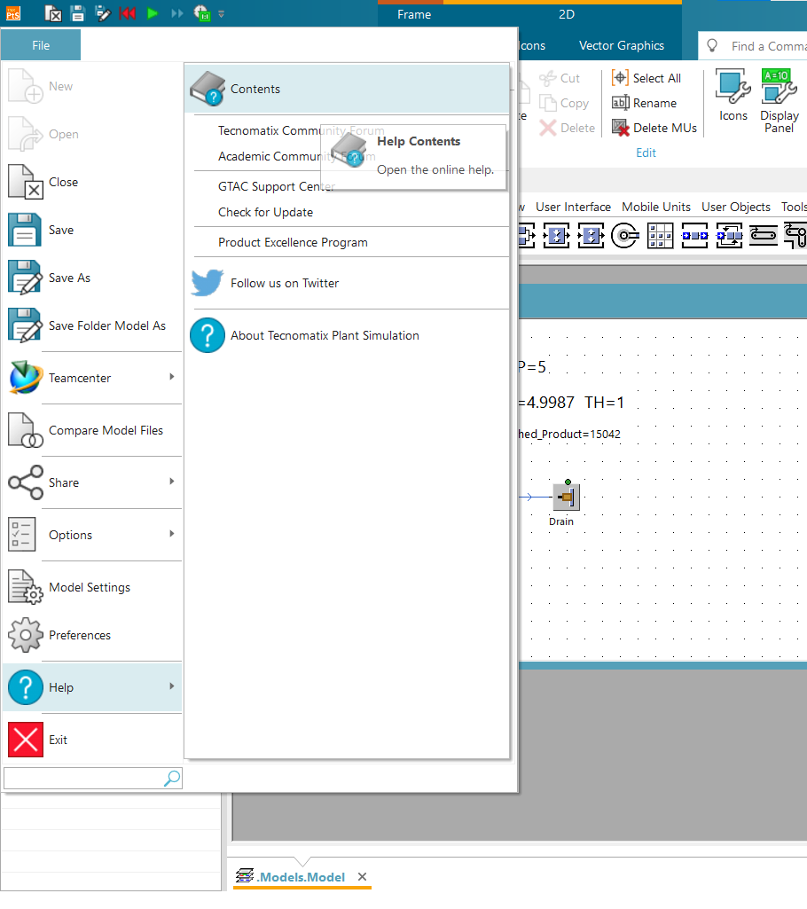
Task 1 - Help
If you want to figure out anything that is not clear or if you want to learn more, try utilizing the help function.

Slide 32
Task 1 – Warm up
Let’s shortly discuss: The way we have set up our simulation model: Which of the scenarios does it reflect?
A: The best-case scenario
B: The worst-case scenario
C: The practical worst-case scenario
D: None of these

Slide 33

Task 1 – Warm up
Let’s shortly discuss: The way we have set up our simulation model: Which of the scenarios does it reflect?
A: The best-case scenario
B: The worst-case scenario
C: The practical worst-case scenario
D: None of these

Slide 34
Task 1 – Warm up
Let’s shortly discuss: If we remove the Buffer before Rimming and use a Connector connecting the Tail Stamping and Rimming directly. What will happen to the overall CT and the overall TH and why?
Set WIP to 1 and to 8 and capture the differences in TH and CT when comparing the buffer vs. the non-buffer configuration before Rimming.
Explain the results using the term ‘blocking’, (Hint: [station] – [statistics tab])
 | TH | CT
WIP = 1, Buffer existing
WIP = 1, Buffer removed
WIP = 8, Buffer existing
WIP = 8, Buffer removed

Slide 35
3. Homework

Slide 36
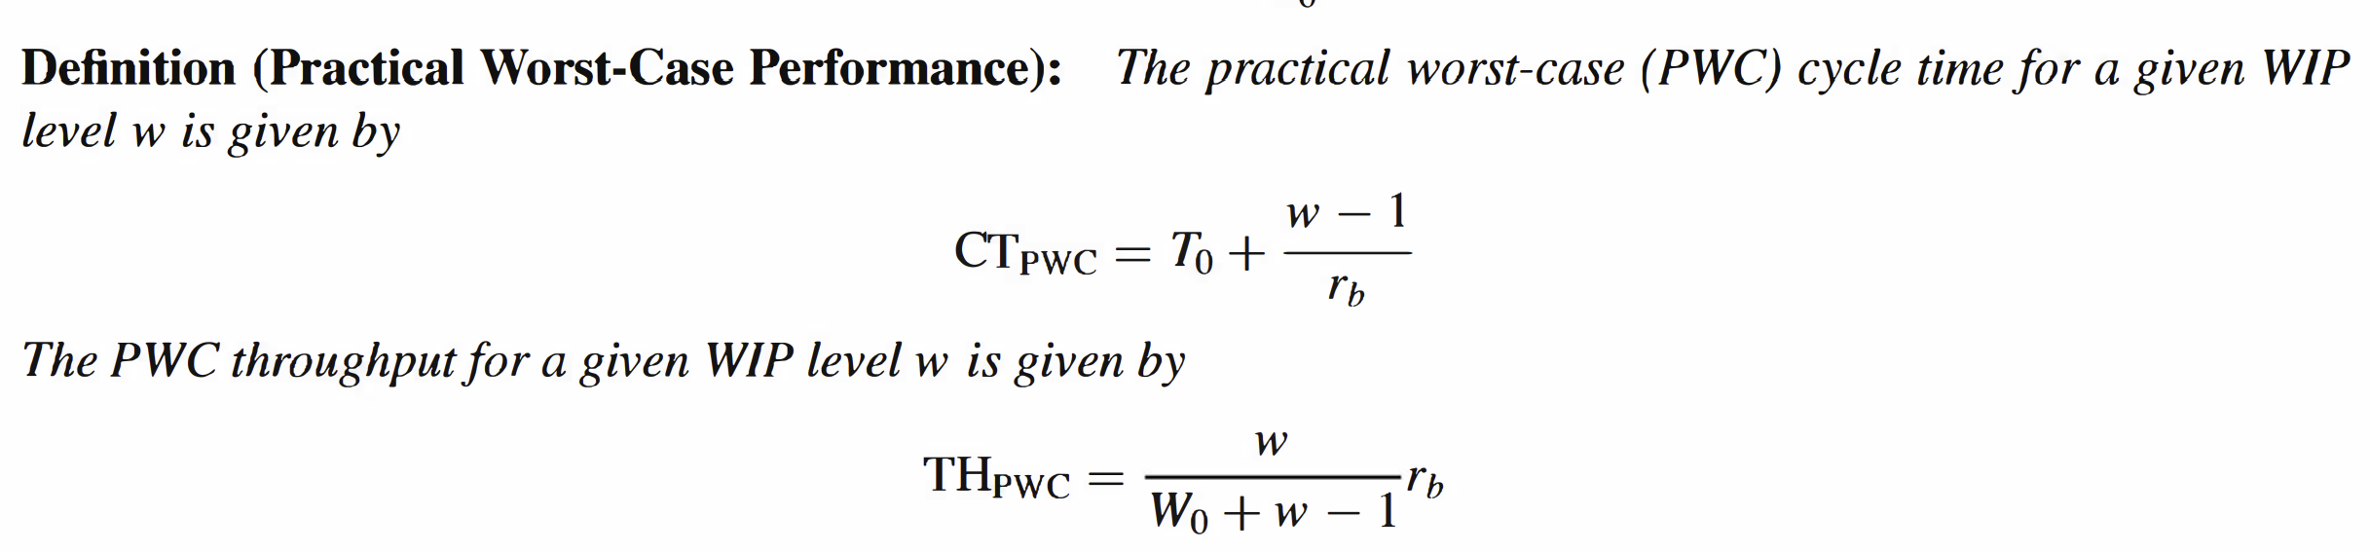
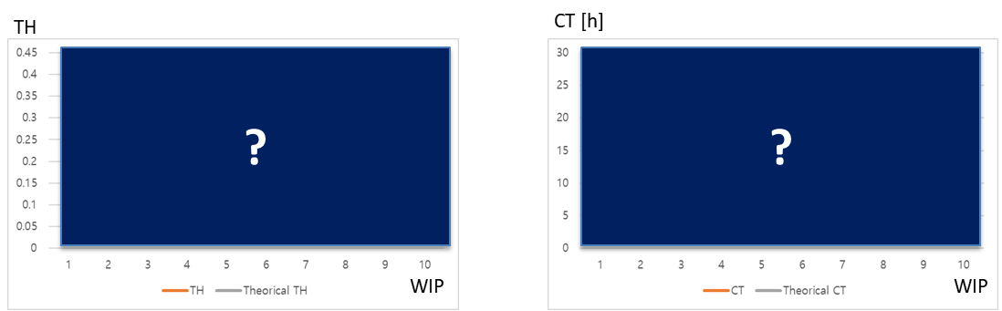
Task 1 - Penny Fab – Exponential Distribution
[HOMEWORK]
Take the simulation model from the warm-up. Increase WIP level from 1 to 10, draw two graphs, TH vs. WIP and CT vs. WIP, and analyze the result. Is it consistent with the values obtained by PWC equation in our textbook? & Explain: Why or why not?
+ why?

Slide 37
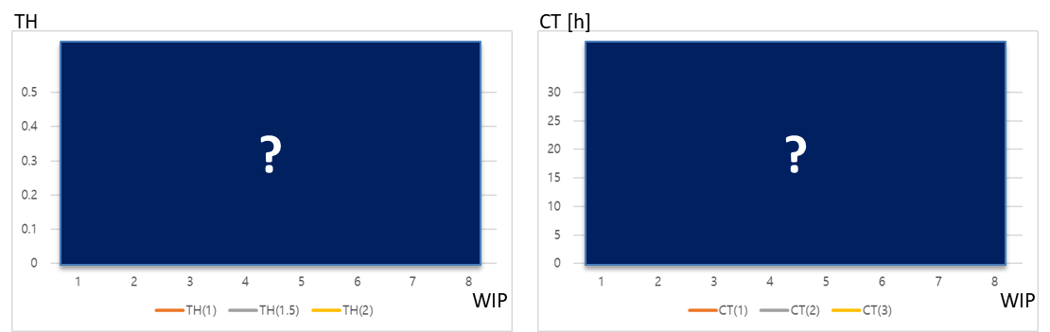
Task 2 - Penny Fab – Normal Distribution
[HOMEWORK]
This time, Penny Fab is as illustrated in figure, and processing times follow normal distribution. Each machine takes an average of two hours to complete its task and has a lower bound and upper bound processing time limit of 0 and 20 hours respectively.
For each standard deviation, which includes 1 hour, 1.5 hours, and 2 hours, increase WIP level from 1 to 8 and draw TH vs. WIP in one graph. Analyze the result. Is there a tendency in the graph? Explain why.
+ why?
b) Compare the performance when the WIP level is at 6 with the "practical worst-case" described in problem 1.

Slide 38
Thank you
For further inquiries: lennard.heuer@kaist.ac.kr

